Slide 1
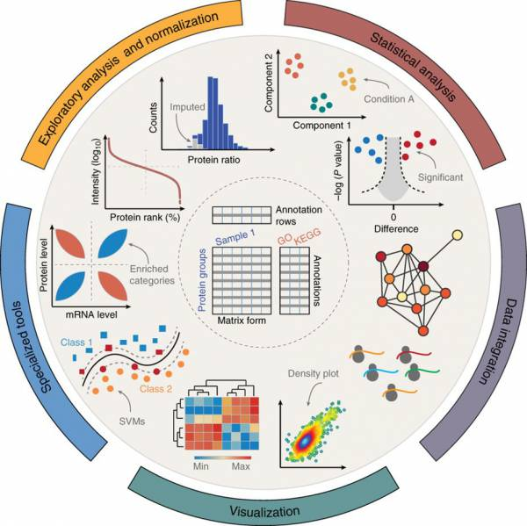


How to Create Volcano Plots in Perseus
Kyle Swovick, PhD
Mass Spectrometry Resource Lab
Center for Advanced Research Technologies, University of Rochester Medical Center

Slide 2
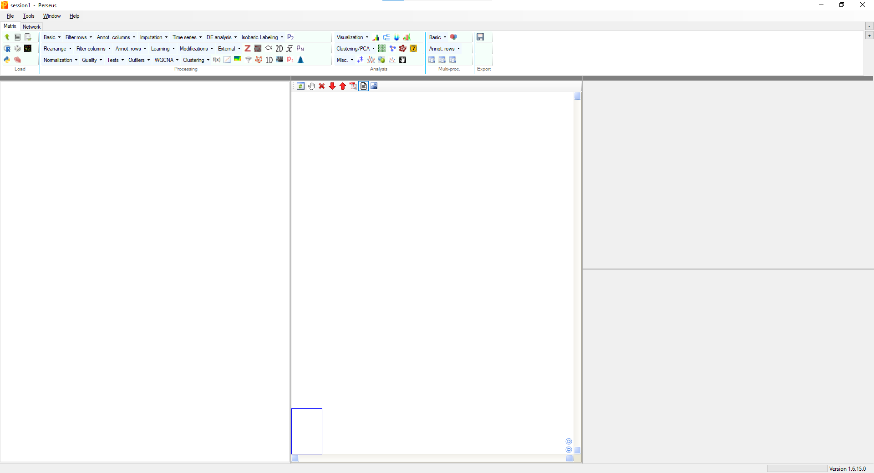
Upload your file

Slide 3
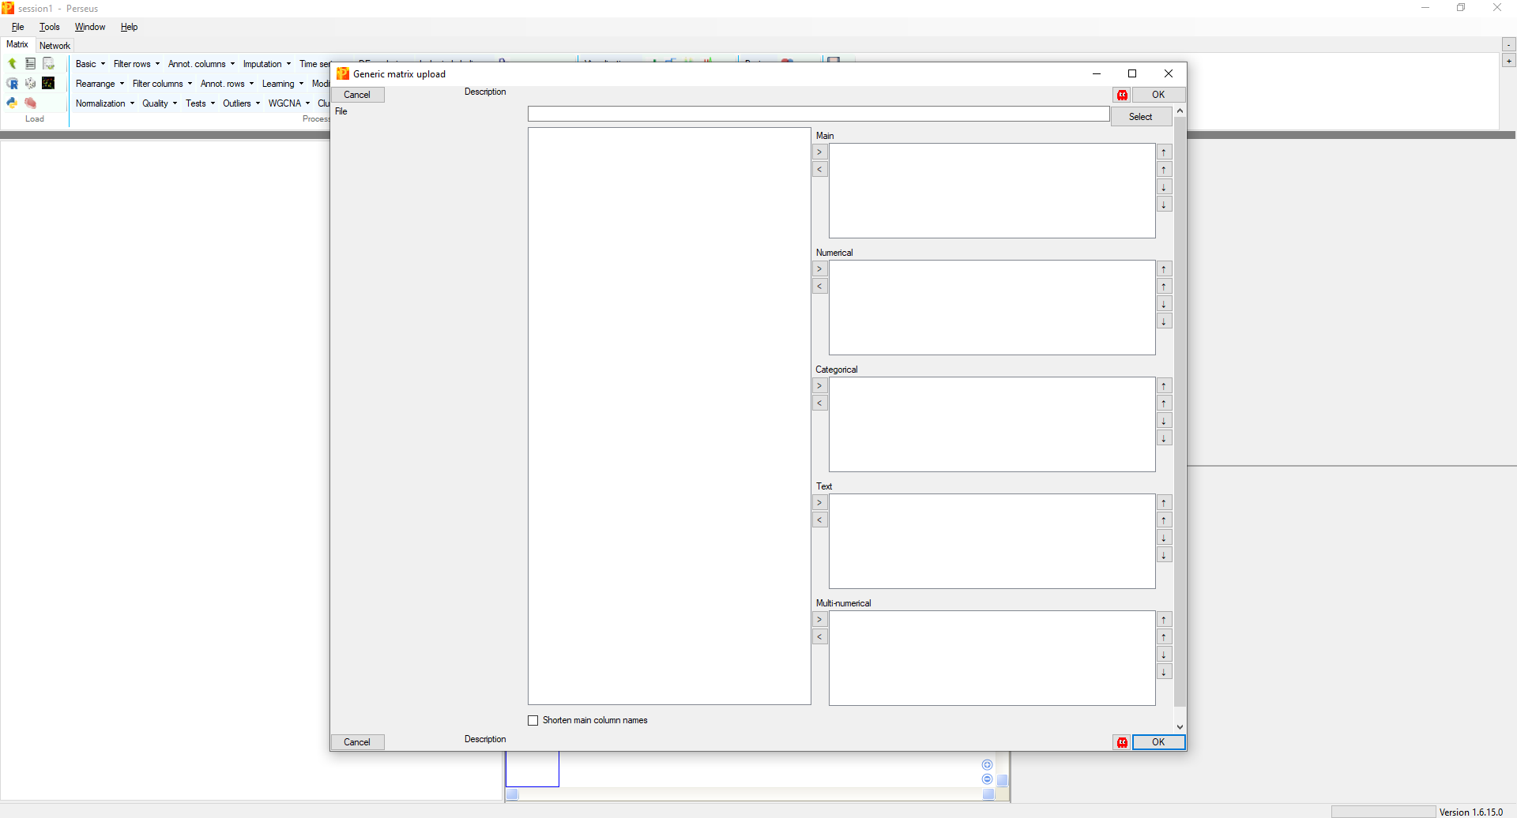
Upload your file

Slide 4
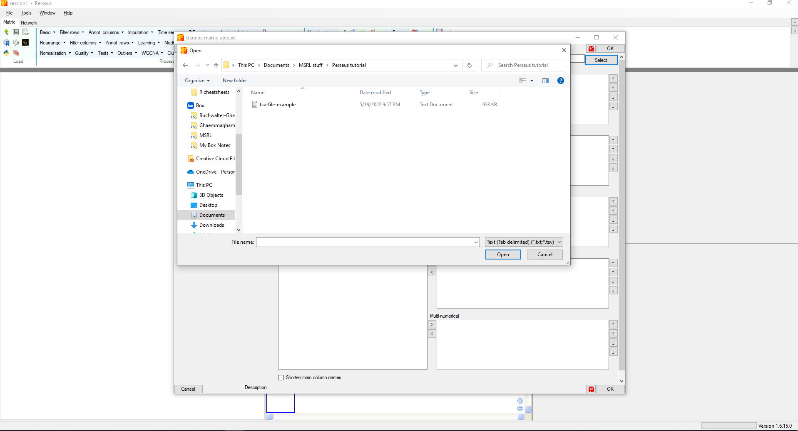
Upload your file (tab separated file; .txt or .tsv)
Ensure that you are correcting the correct file format!

Slide 5
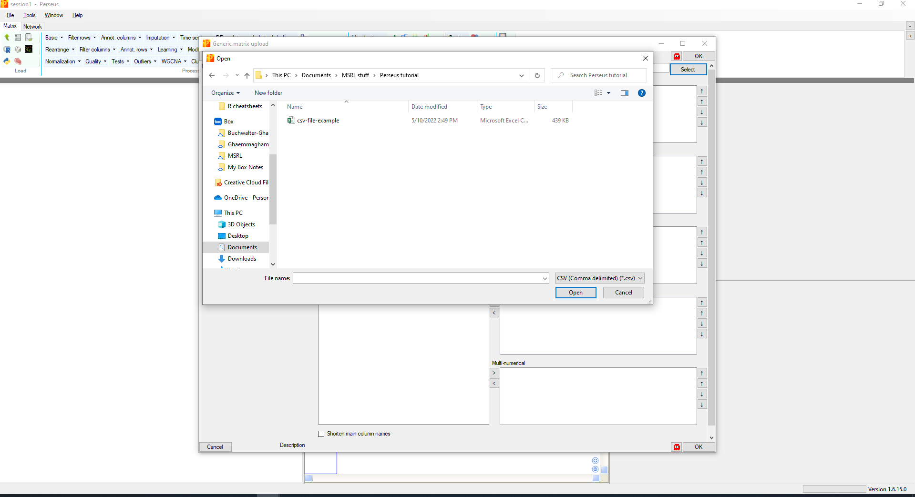
Upload your file (comma separated file; .csv)
Ensure that you are correcting the correct file format!

Slide 6
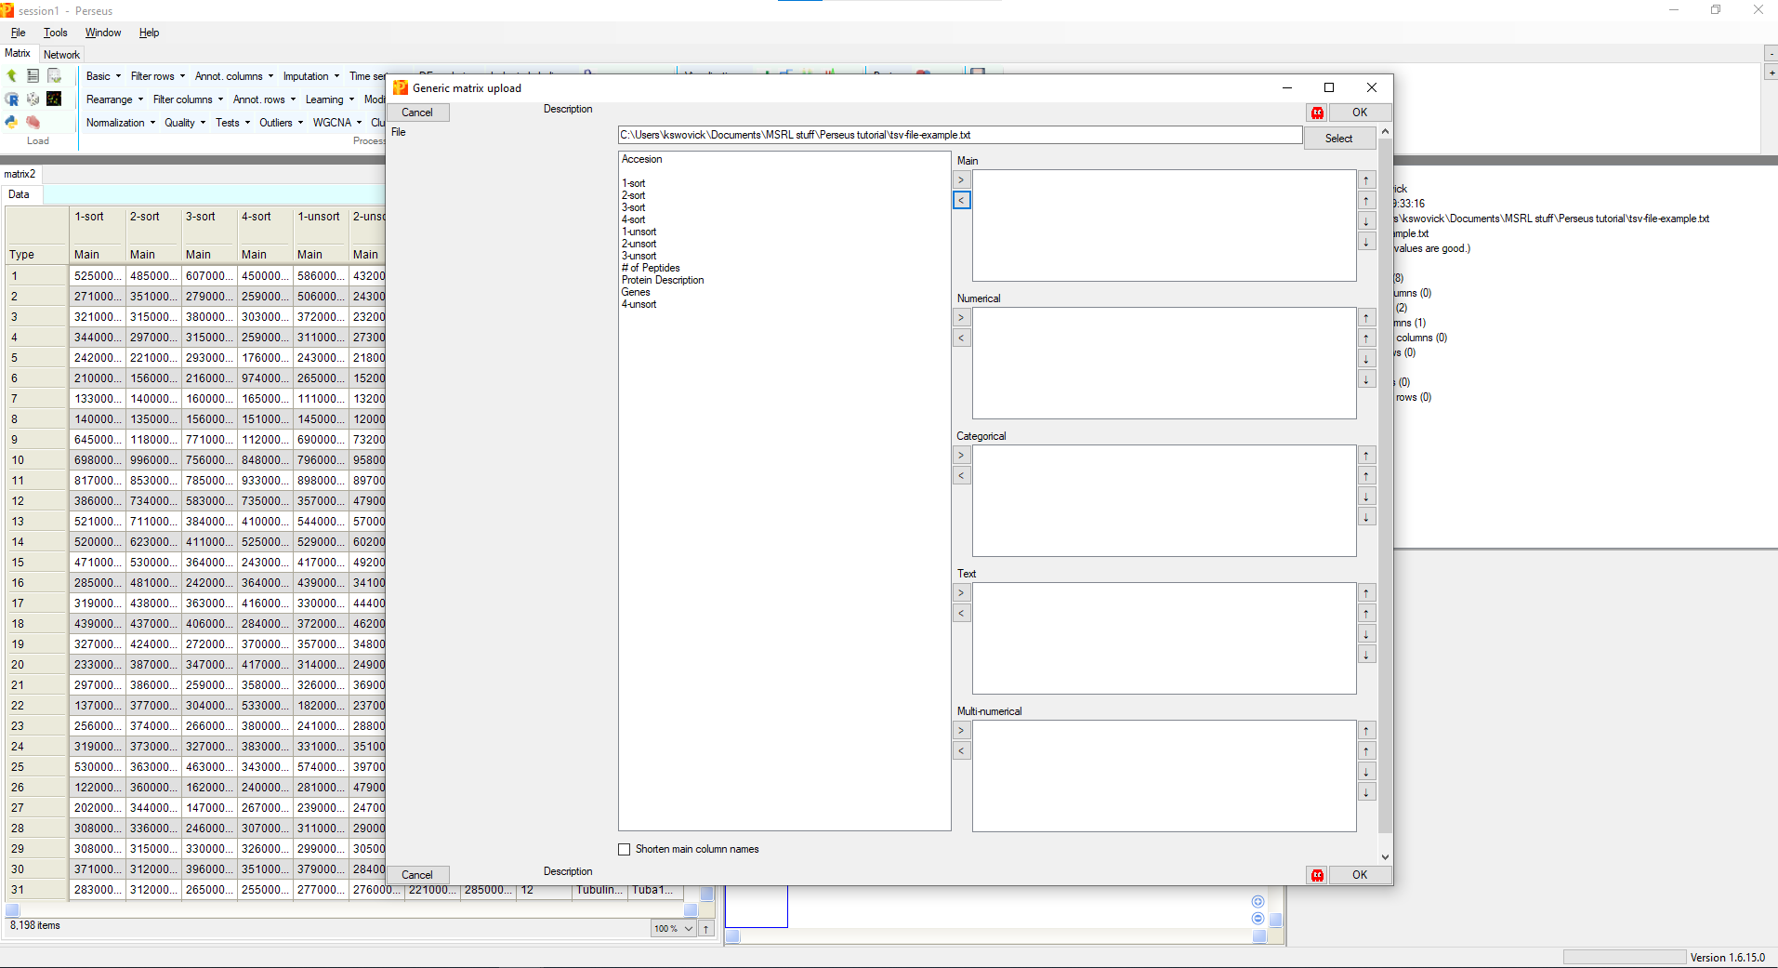
Assign information to your data

Slide 7
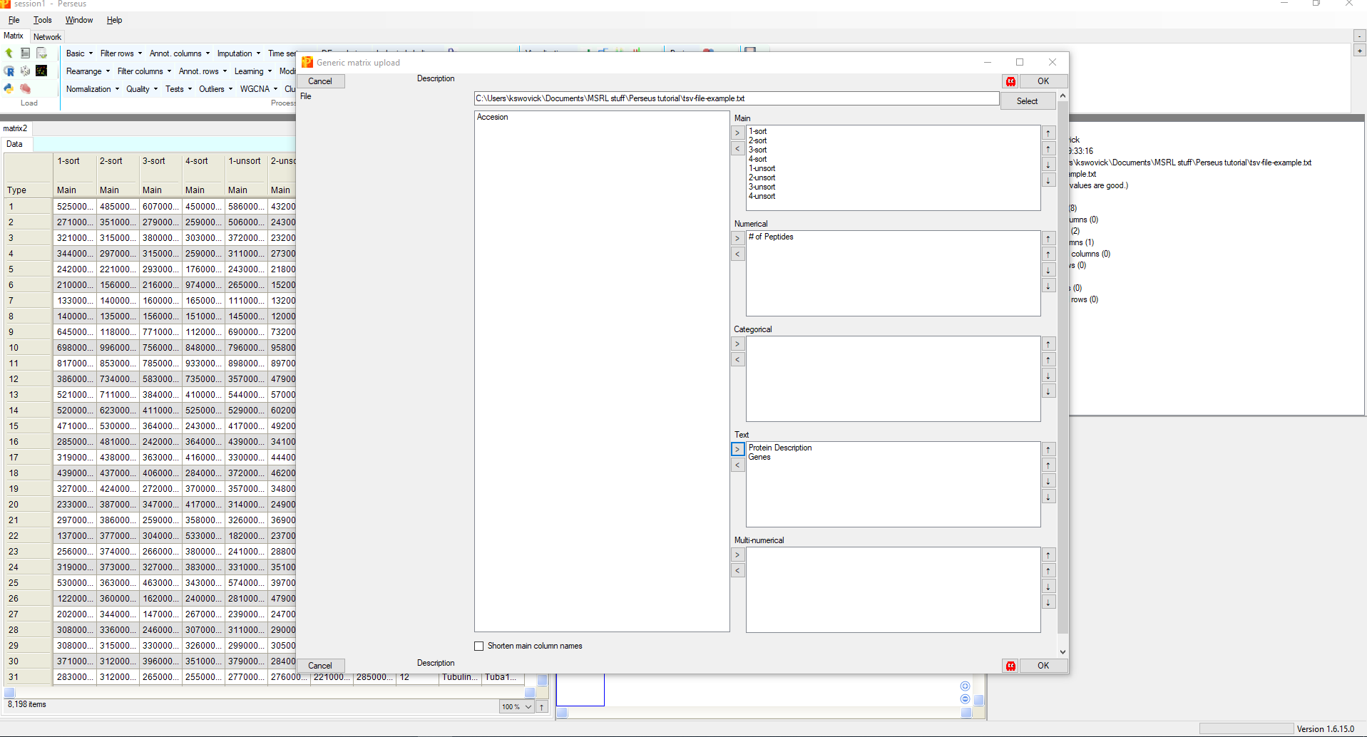
Assign information to your data

Slide 8
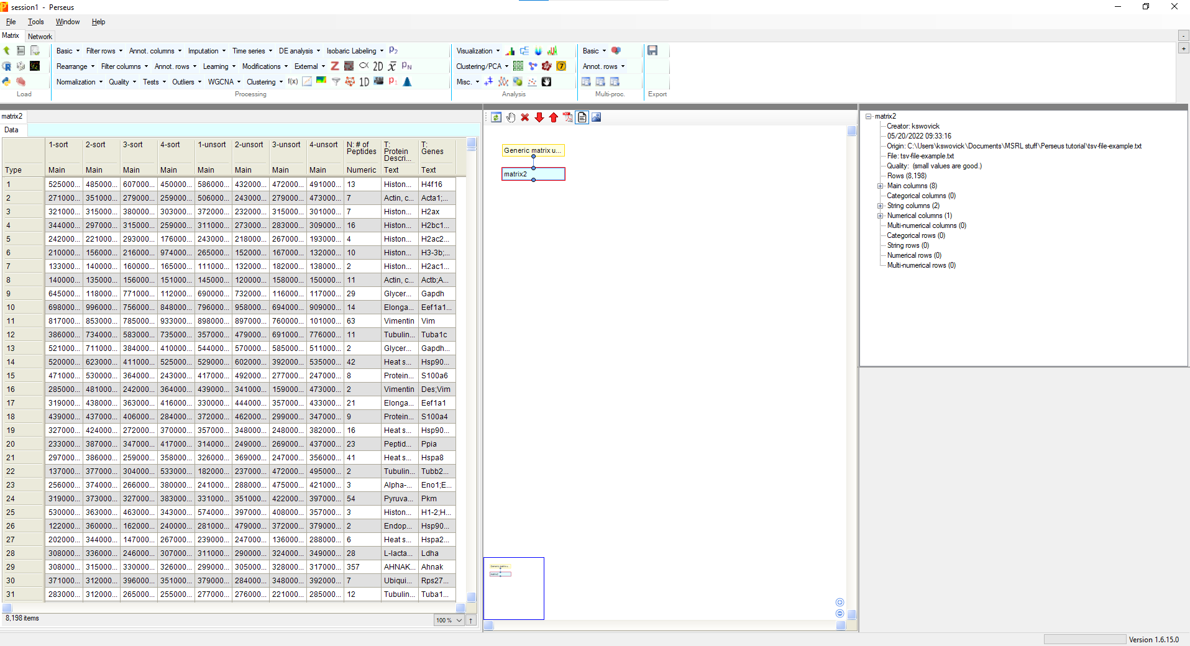
Create Groups

Slide 9
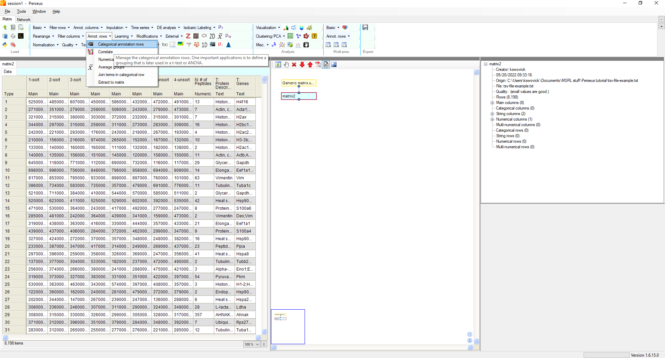
Create Groups

Slide 10
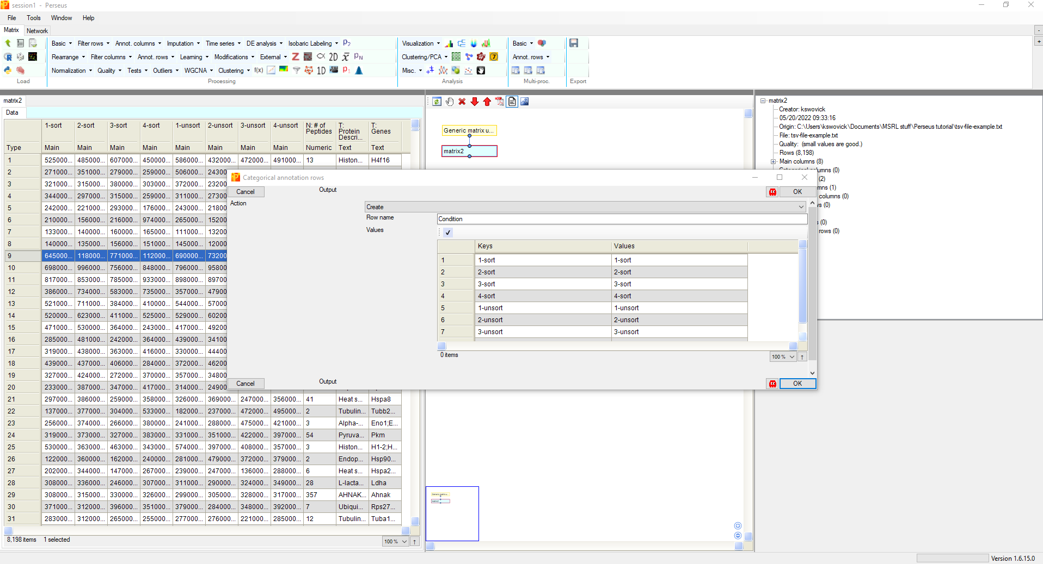
Create Groups
Rename the category to something useful (i.e. Condition)
Ensure all the samples you want to compare are included

Slide 11
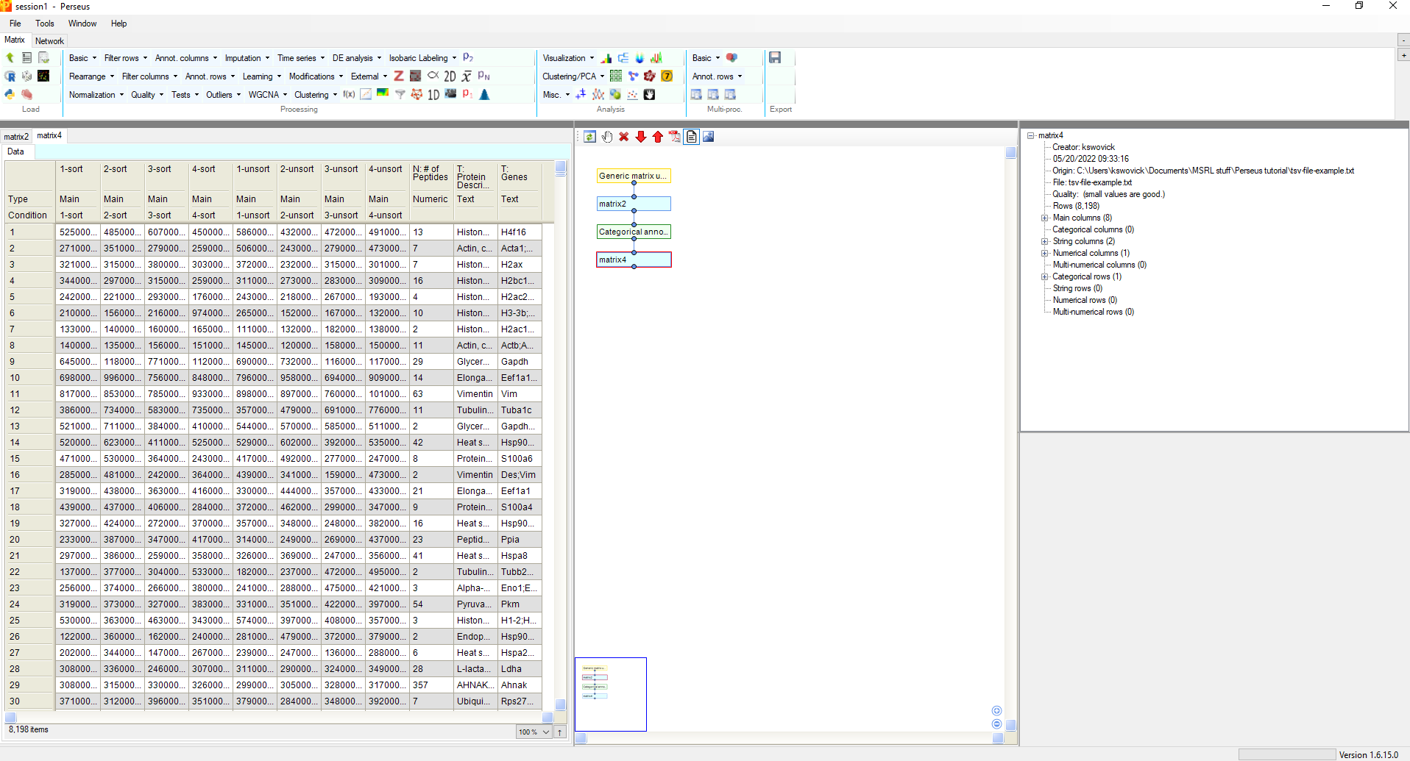
Create Groups

Slide 12
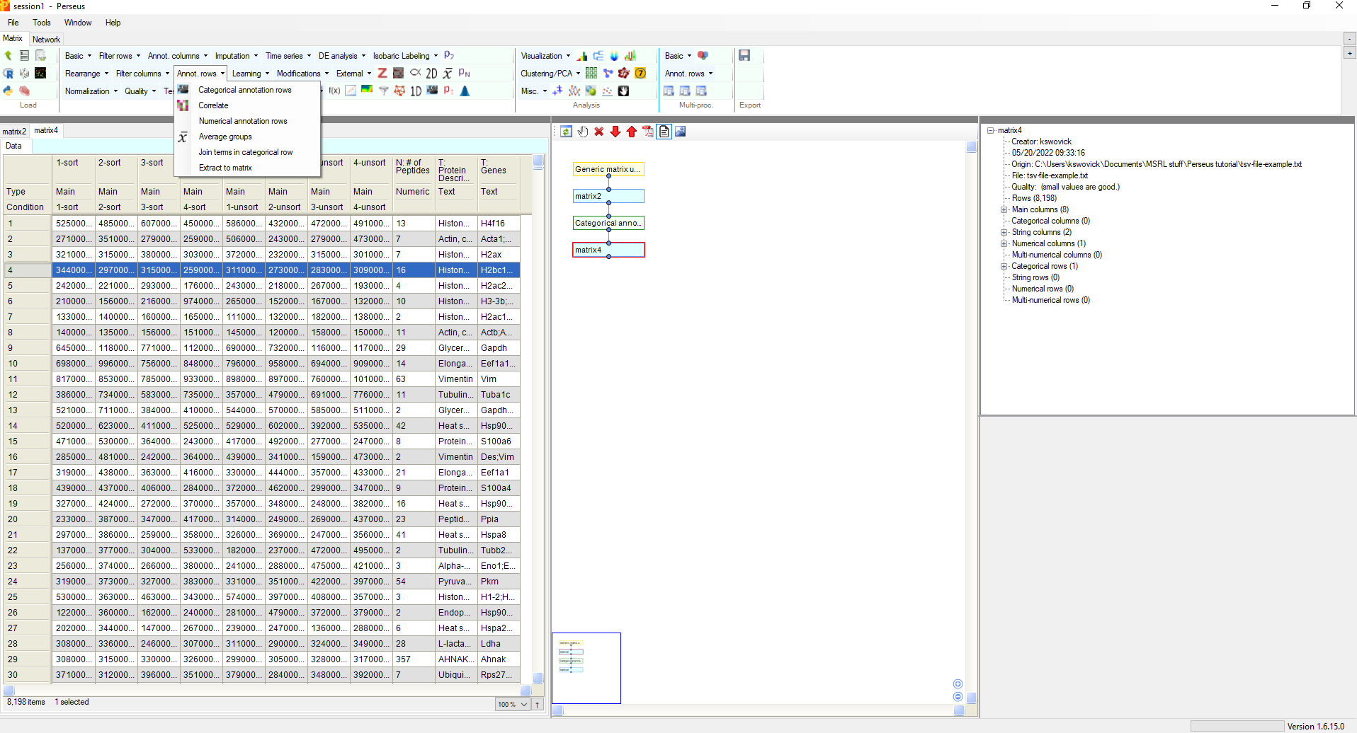
Create Groups

Slide 13
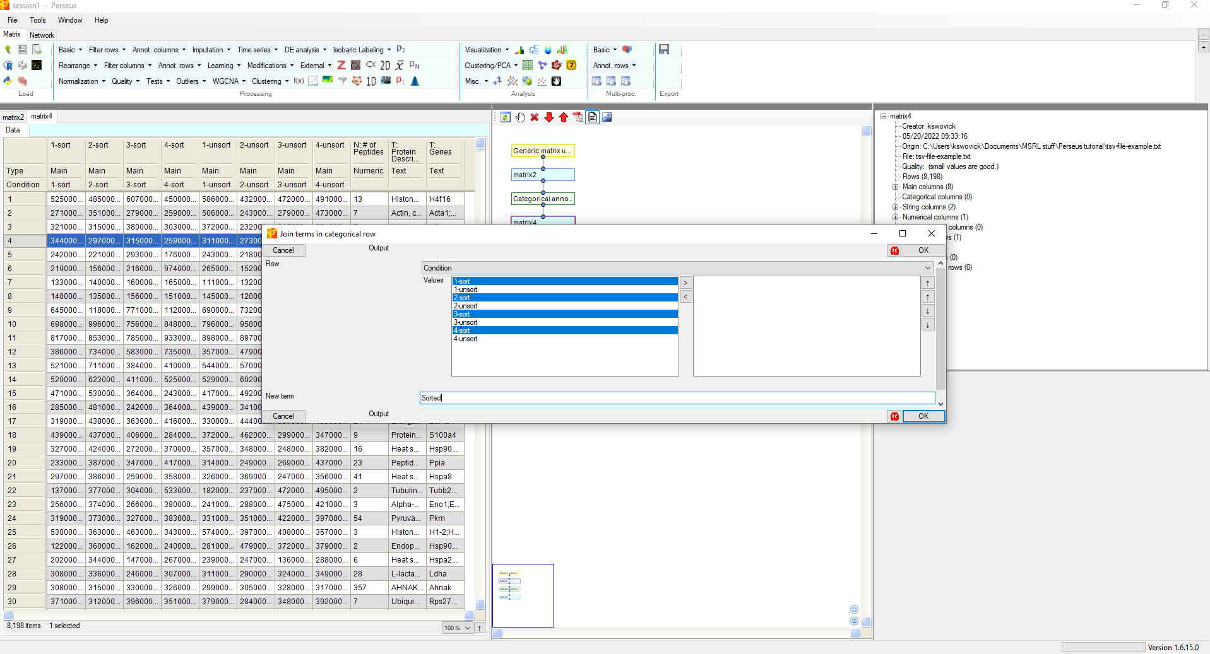
Create Groups
Give the group a useful name

Slide 14
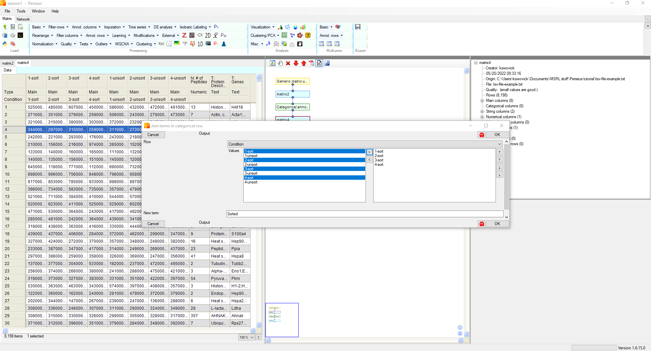
Create Groups

Slide 15
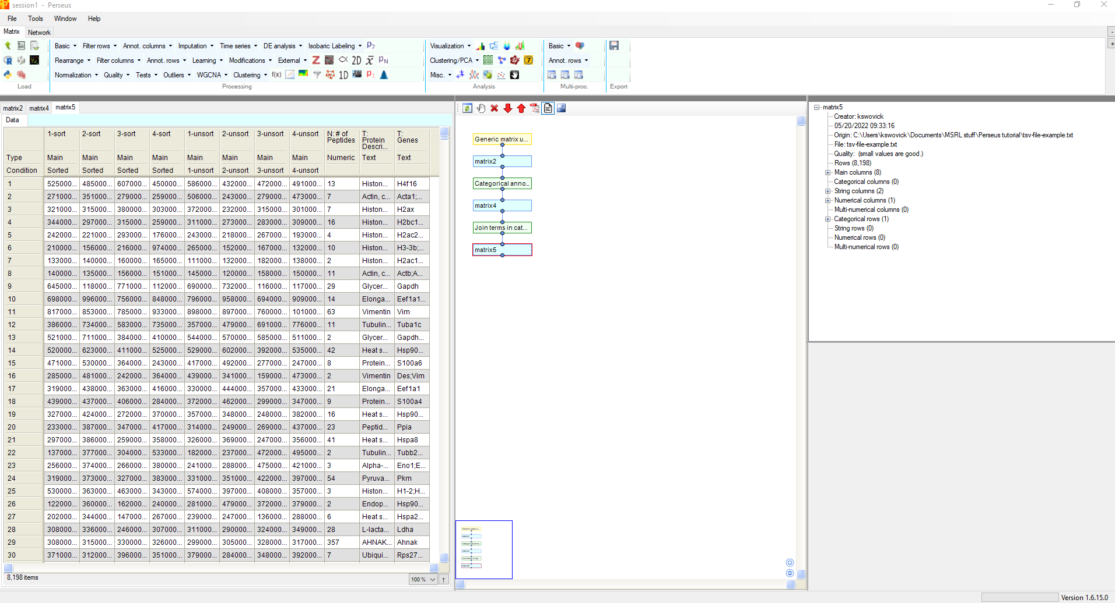
Create Groups

Slide 16
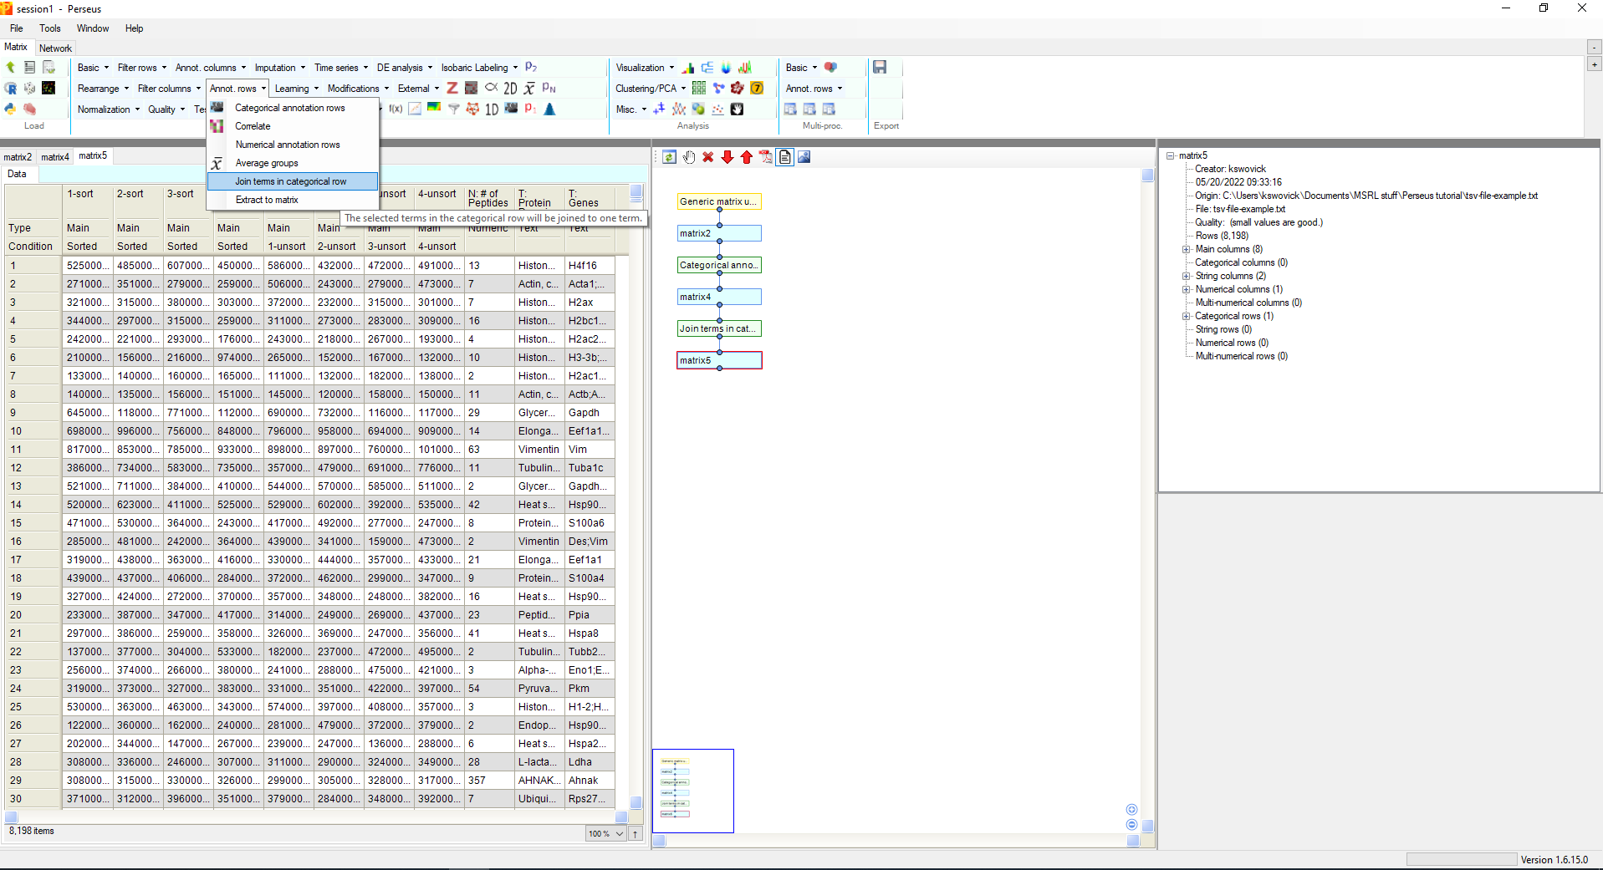
Create Groups

Slide 17
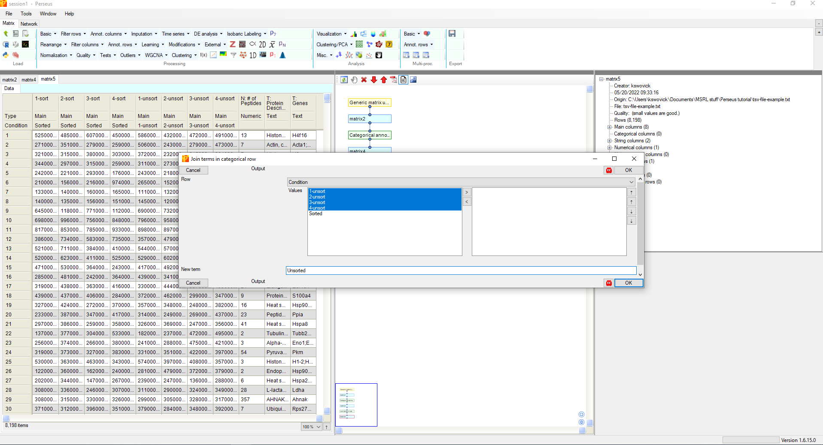
Create Groups
Give this group a different name

Slide 18
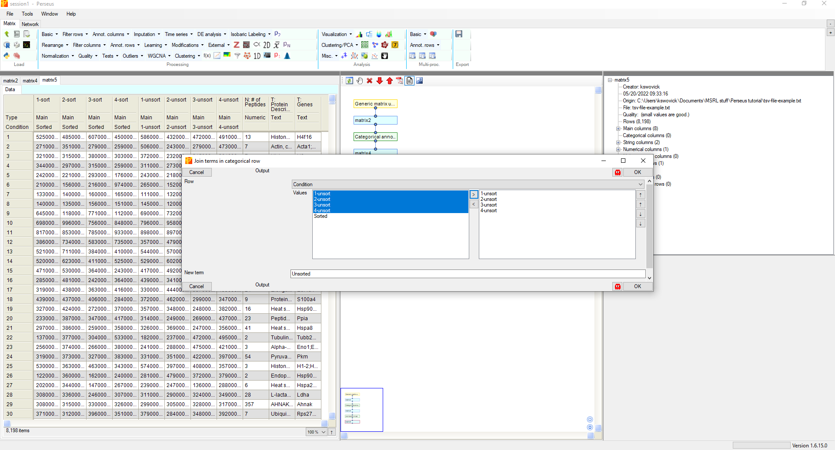
Create Groups

Slide 19
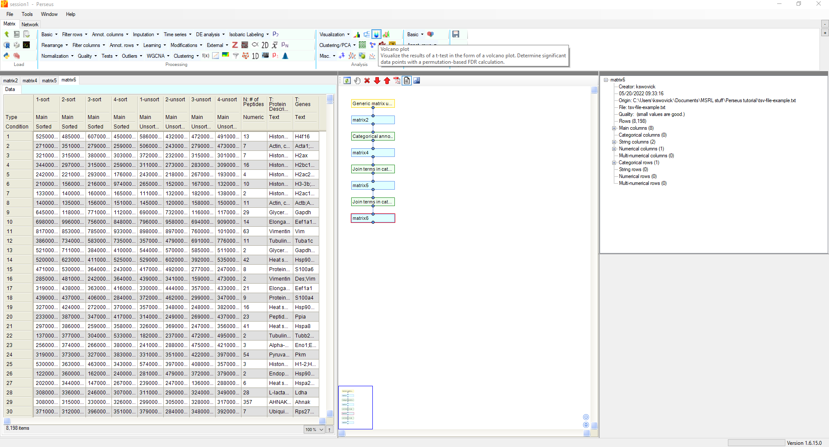
Create a volcano plot

Slide 20
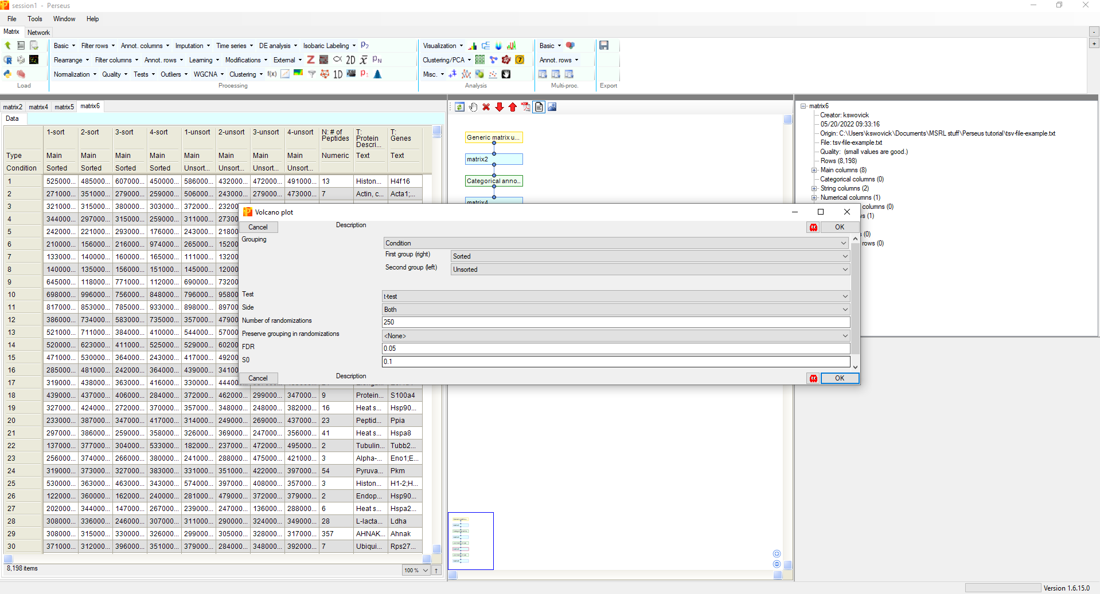
Create a volcano plot
These are the default values. They are sufficient for many cases, but you can change them if you want a higher significance threshold or need to use a different test.

Slide 21
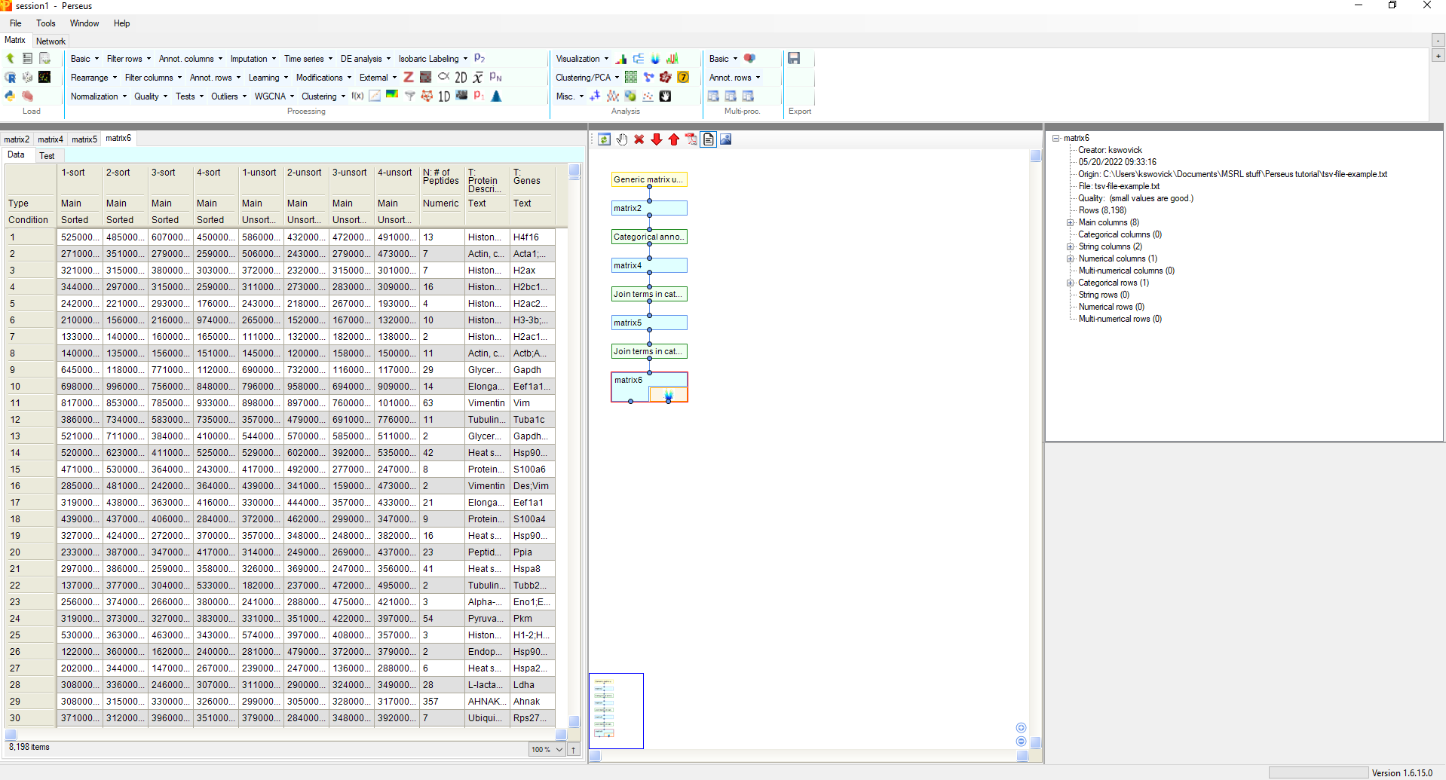
Create a volcano plot

Slide 22
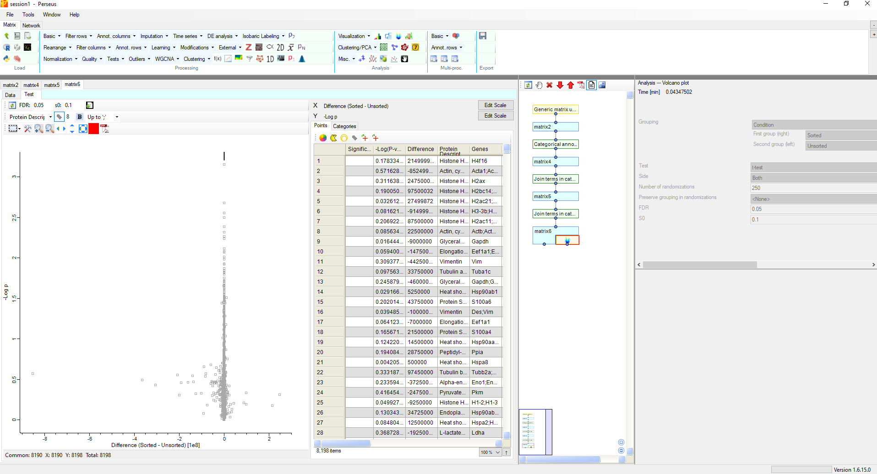
Edit your volcano plot
You can change the appearance of your plot here to fit how you like.

Slide 23
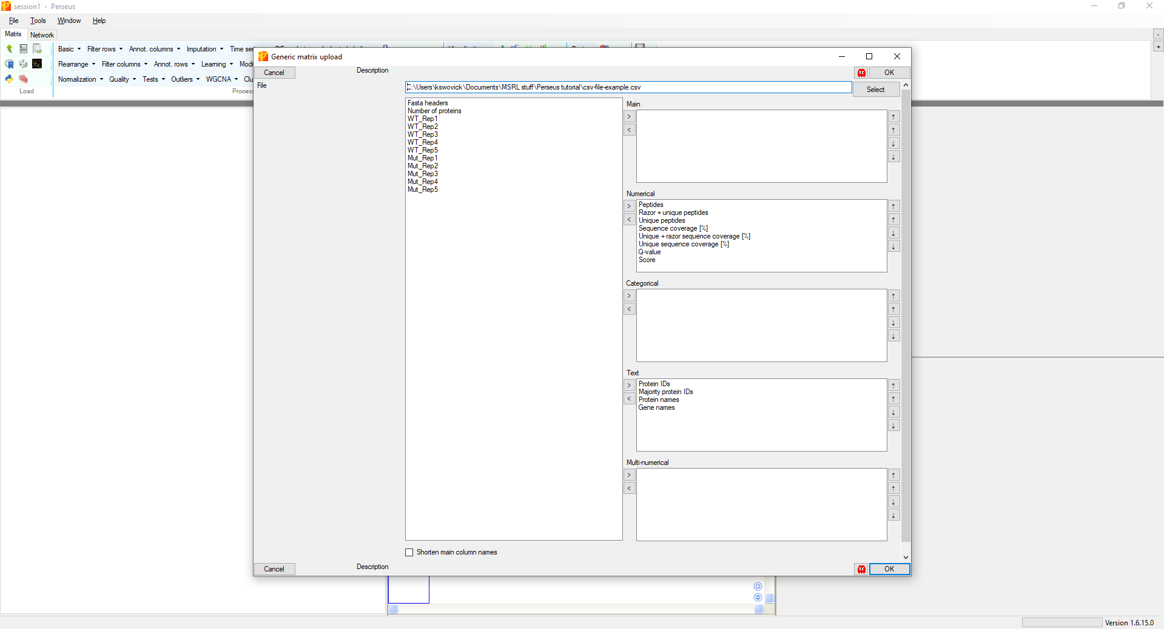
Assign information to your data-MaxQuant
For some files (generated from MaxQuant), fields will auto-populate

Slide 24
Assign information to your data-MaxQuant
Assign result columns

Slide 25
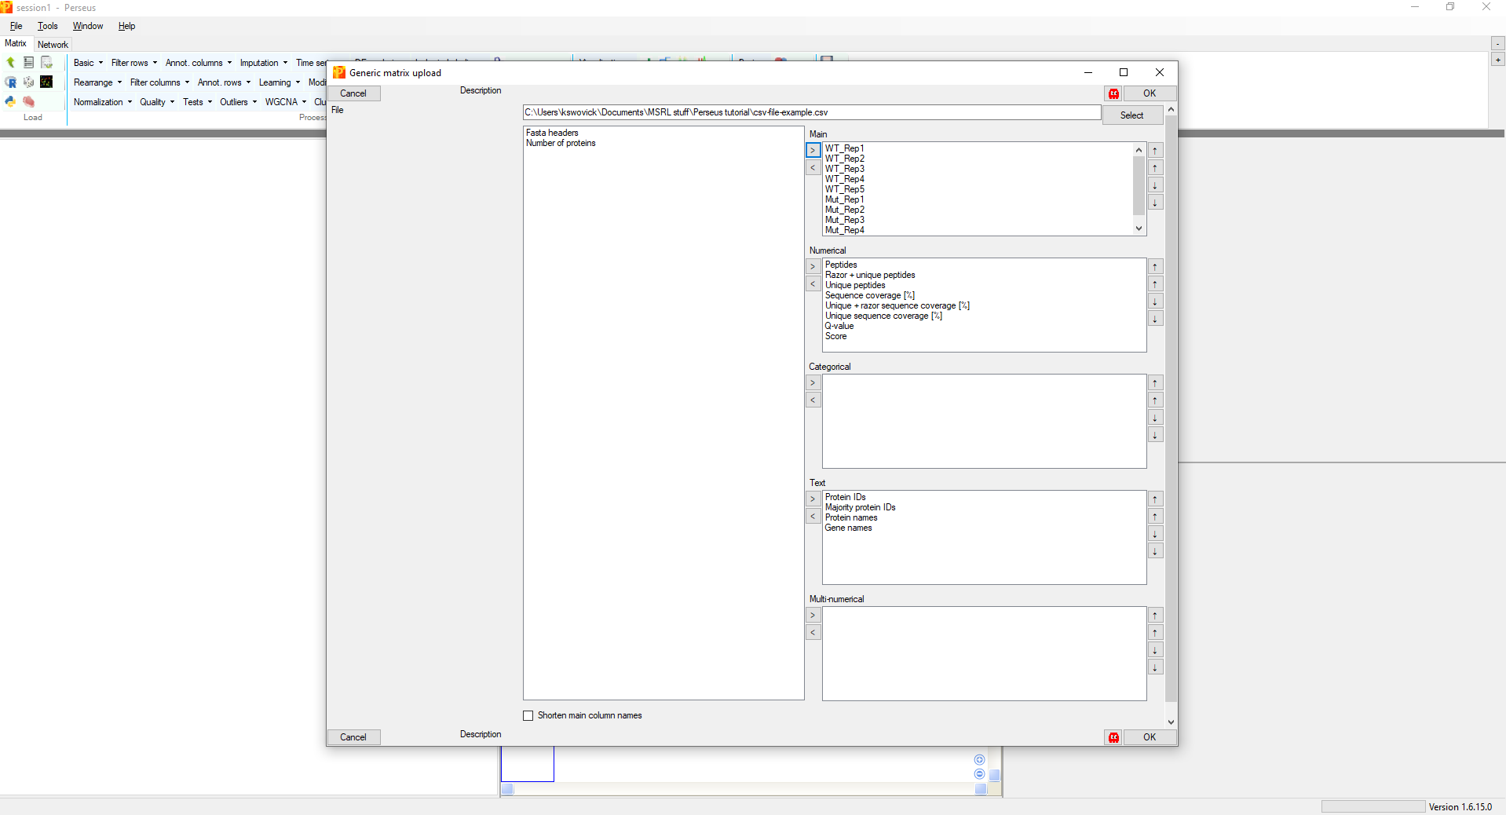
Assign information to your data-MaxQuant

